Slide 1
Lecture 1: Introduction to Computer Programming Course - CS1010
DEPARTMENT OF COMPUTER SCIENCE | 08/30/2019

Slide 2
Welcome to CS1010!
Meet the Instructor(s):
Course Instructor: Dr. Uzma Mushtaque, PhD | mushtu@rpi.edu
Office Location: Amos Eaton 111
Office Hours: Tuesday: 12:00 pm to 1:30 pm Friday: 12:00 pm to 1:30 pm Or by appointment.
Course (Teaching Assistant)TA: Jessup Barrueco | barruj@rpi.edu
Office Location: | Lally lab
Office Hours: | Wednesday 3-4pm
Course Mentors:
Shreya Barua | baruas@rpi.edu
William Asai | asaiw@rpi.edu
Patrick Berne | bernep@rpi.edu

Slide 3
Structure of Lectures/Class Meeting
Tuesday
Introduction to a new topic.
Mostly Lecture and Discussions
Few in–class exercises
Might have a 10 minutes break
Friday
Continue the Topic from Monday
Mostly in-class exercises to be submitted in class
Some part can be lecture and/or discussion

Slide 4
Before Starting
Please have a look at the syllabus
Be aware of the course schedule
Home-works
Exams
Office -hours
There is a recommended textbook for the course (not required): Practical Programming: An Introduction to Computer Science Using Python by Campbell, Gries, and Montojo (2nd Edition)

Slide 5
Course Assessment Measures
Lecture Exercises: 5%,
Homework: 40%,
Tests: 35%,
Final: 20% .
Assessment | Number
Exam/Tests | 2-3
Homework | 7-9
In class exercise | 16-18
Final Exam | 1

Slide 6
Software Requirements
We will use Python as the Programming Language for this course.
Install Python 3.6
Use Spyder as the IDE (Integrated Development Environment)
We will download and Install Miniconda in Class next week.
Please bring your computers to class on Tuesday.

Slide 7
Resources
Use Submitty to submit your homework and other coding assignments
https://submitty.cs.rpi.edu/f19/csci1010
Check the course website for all the material
To go to the course website:
log onto Submitty
Click the ‘Course home’ link on the top left
OR Directly go to: https://www.cs.rpi.edu/~mushtu/CS1010/index.html

Slide 8
Course Goals
Ultimately, to give give you the acumen required to solve everyday problems with code.
To convince, motivate and inspire you to see your problems as solvable in an objective manner, with computer science.
Show you how computers work and that programming is fun.

Slide 9
77%
percentage of jobs in the US requiring technology skills by 2025
Notes:
Bureau of labor statistics

Slide 10
Review

Slide 11
Computers Don’t Byte!

Slide 12
What is a computer?
Noun: “an electronic device for storing and processing data, typically in binary form, according to instructions given to it in a variable program.”
How many computers do you have on you at this given moment.
Laptop, Watch, Phone, Calculator

Slide 13
Parts of a Computer System:
Hardware: Electronic Devices
Software: Instructions and Computer Programs

Slide 14
That’s great, but how does a computer use these components to “think”?

Slide 15
Computer Language
Digital devices have two stable states, which are referred to as zero and one by convention
Binary Language: Data and instructions (numbers, characters, strings, etc.) are encoded as binary numbers - a series of bits (one or more bytes made up of zeros and ones)

Slide 16
Computer Language (cont.)
Encoding and decoding of data into binary is performed automatically by the system based on the encoding scheme
Encoding schemes
Numeric Data: Encoded as binary numbers
Non-Numeric Data: Encoded as binary numbers using representative code
ASCII – 1 byte per character
Unicode – 2 bytes per character

Slide 17
Programming Languages
Computers can not use human languages, and programming in the binary language of computers is a very difficult, tedious process
Therefore, most programs are written using a programming language and are converted to the binary language used by the computer
Three major categories of prog languages:
Machine Language
Assembly Language
High level Language

Slide 18
High Level Languages
English-like and easy to learn and program
Common mathematical notation
Total Cost = Price + Tax;
area = 5 * 5 * 3.1415;
Java, C, C++, VISUAL BASIC, Python

Slide 19
Compiling Source Code
A program written in a high-level language is called a source program (or source code). Since a computer cannot understand a source program. Program called a compiler is used to translate the source program into a machine language program called an object program. The object program is often then linked with other supporting library code before the object can be executed on the machine.

Slide 20
Programming
Programming – the creation of an ordered set of instructions to solve a problem with a computer.
Different programs will just use these instructions in different orders and combinations.
The most valuable part of learning to program is learning how to think about arranging the sequence of instructions to solve the problem or carry out the task

Slide 21
Programming Fundamentals: Putting the Instructions Together
Sequential Processing: A List of Instructions
Conditional Execution : Ifs
Repetition: Looping / Repeating
Stepwise Refinement / Top-Down Design : Breaking Things into Smaller Pieces
Calling Methods / Functions / Procedures / Subroutines
Calling a segment of code located elsewhere
Reuse of previously coded code segment
Notes:
List of Instructions – Remember the Peanut Butter Sandwich, it had to be created in order (sequence)
Ifs – Tasks performed based on a Condition → If it is cold, Wear a Jacket
Repeating Behavior – Jump up and down 3 times. While it is cold wear a jacket
Breaking Things into Smaller Pieces - Take a complicated task and break it down into a list of smaller tasks. We will clean the house → first clean kitchen, then clean bathroom, then clean one bedroom
Compute a Result – Perform the smaller tasks to obtain the result or answer to a question
Programming will use these ideas in various combinations
Only about 100 instructions that the computer understands. Different programs will just use these instructions in different orders and combinations.
The most valuable part of learning to program is learning how to think about arranging the sequence of instructions to solve the problem or carry out the task

Slide 22
Methods of Programming
Procedural
Defining set of steps to transform inputs into outputs
Translating steps into code
Constructed as a set of procedures
Each procedure is a set of instructions
Object-Oriented
Defining/utilizing objects to represent real-world entities that work together to solve problem
Basic O-O Programming Components: Class, Object, Properties, Methods

Slide 23
Problem Solving
The process of defining a problem, searching for relevant information and resources about the problem, and of discovering, designing, and evaluating the solutions for further opportunities. Includes:
Finding an Answer to a Question
Figuring out how to Perform a Task
Figure out how to Make Things Work

Slide 24
4 Steps of Problem Solving (Polya’s)
U – Understand the Problem
D – Devise a Good Plan to Solve
I – Implement the Plan
E – Evaluate the Solution
Notes:
George Polya – 1950’s
Understand the Problem –
Ask Questions
Completely Understand what is being asked
What are the requirements, what is expected
Devise a Good Plan to Solve the Problem
Develop your Algorithm – AT LEAST ONE
Implement the Plan – Follow through with your algorithm
For us, we will write the flowchart, write the program, etc.
Evaluate the Impelementation
Did it work??
Did it solve the problem correctly and completely???
Is there another way to solve the Problem???
Multiple Solutions – Which one was better, faster, easier??

Slide 25
Example: Solving Math Word Problem
Read the Problem: Understand the description of problem or scenario, identifying the knowns and unknowns
Decide how to go about solving the problem: Determine what steps need to be taken to reach the solution
Solve the Problem: Write the solution
Test the Answer: Make sure the answer is correct

Slide 26
Solving Computing Problems
In general, when we solve a computing problem we are taking some inputs, processing (performing some actions on) the inputs, and then outputting the solution or results.
This is the classic view of computer programming – computation as calculation
Polya’s steps (UDIE) can be very effective when applied to solving computing problems

Slide 27
Applying Polya’s Problem Solving to Programming Step 1 - Understand the Problem
What is the Problem to be solved? What is the unknown? What is the condition? What is the data? What is needed to solve the problem? What actions need to take place?
Identify the inputs and outputs
Identify the processes needed to produce the outputs from the given inputs
Draw a figure. Introduce suitable notation.
Isolate Principle parts of the problem.

Slide 28
Applying Polya’s Problem Solving to Programming Step 2 - Devise a Plan
Find connections between the knowns and unknowns.
Simplify: Break the problem into smaller sub-problems
Design a solution
Make a plan or list of actions to implement the solution
Algorithm / Flowchart / Psuedocode

Slide 29
Applying Polya’s Problem Solving to Programming Step 2 - Devise a Plan (cont.)
Algorithm
A FINITE set of clear, executable steps that will eventually terminate to produce the desired outcome
Logical design used to solve problems – usually a list of actions required to perform task
Pseudocode
Written like program code but more “English Like” and doesn’t have to conform to language syntax
Flowchart
Diagram that visually represents the steps to be performed to arrive at solution.

Slide 30
What is an algorithm? (Plan Continued)

Slide 31
Applying Polya’s Problem Solving to Programming Step 3 - Implement the Plan
Implement in a Programming Language
Carry out the plan checking the preliminary results at each step.
Code A Little Test A lot

Slide 32
Applying Polya’s Problem Solving to Programming Step 4 - Evaluate the Solution
Run the Code
Check results repeatedly and thoroughly
Use numerous test cases or data sets
Use highly varied test case, including expected as well as and unexpected cases
Look for new solutions
Is there a better, easier, or more efficient solution
Can other problems be solved using these techniques?

Slide 33
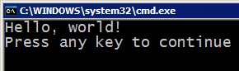
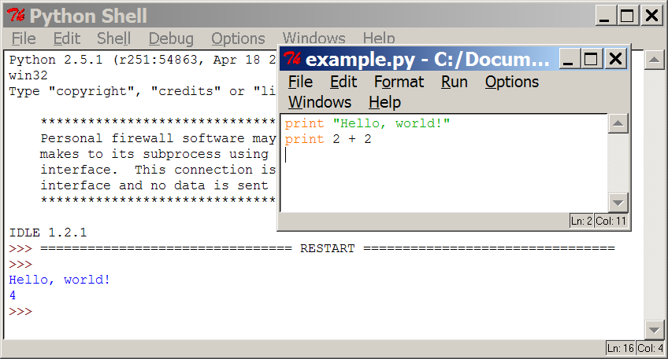
Programming basics
code or source code: The sequence of instructions in a program.
syntax: The set of legal structures and commands that can be used in a particular programming language.
output: The messages printed to the user by a program.
console: The text box onto which output is printed.
Some source code editors pop up the console as an external window, and others contain their own console window.

Slide 34

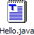
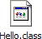

Compiling and interpreting
Many languages require you to compile (translate) your program into a form that the machine understands.
Python is instead directly interpreted into machine instructions.
compile
execute
source code
Hello.java
byte code
Hello.class
output
interpret
source code
Hello.py
output

Slide 35
Summary
U - Read the Problem Statement
Identify the inputs, outputs, and processes
D - Decide how to Solve the Problem
Create an Algorithm / Flowchart / Psuedocode
I - Program the Code
Implement in Programming Language
E - Test the Solution
Run the Code using numerous, varied test cases
Notes:
Reading the Problem and Designing a Plan are important steps in writing programs. The design is a “plan ahead” strategy that will pay off by saving valuable time as programs get increasingly complicated.

Slide 36
In-Class Exercise
Write an algorithm to serve as how-to instructions for some relatively simple task or activity. You choose the task, should be 10-15 steps in length. Assume you are writing instructions for someone who has never performed task before.

Slide 37
Getting Started in Programming

Slide 38
What is a programming language?
“a vocabulary and set of grammatical rules for instructing a computer or computing device to perform specific tasks.”
Visual Basic.
Python.
Sub Main() Console.WriteLine ("Hello, World!") End Sub
def main(): print("Hello, World!")
both have equivalent output

Slide 39
Why Python?
Simple syntax, interpreted language
Many pre written modules
Easy exposure to advanced concepts
Widely used in many industries

Slide 40
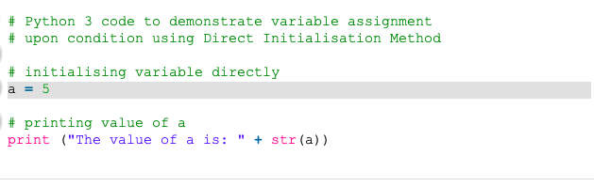
High Level Programming Language
In Python, there is no need to take care about low-level details such as managing the memory used by the program.
No need to declare anything. An assignment statement binds a name to an object, and the object can be of any type.
No type casting required when using container objects

Slide 41
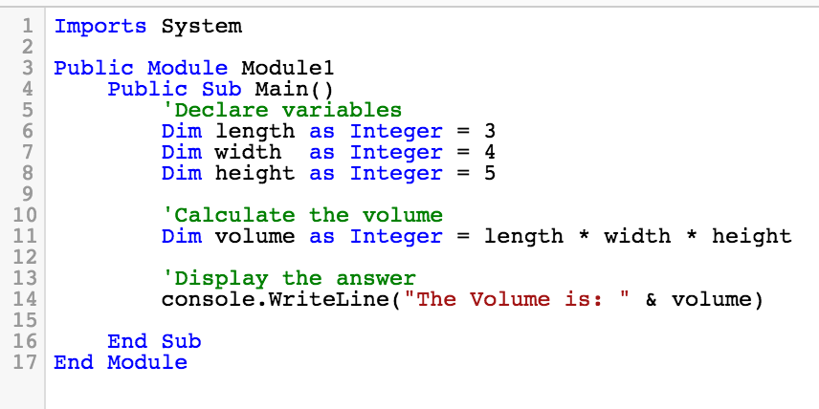
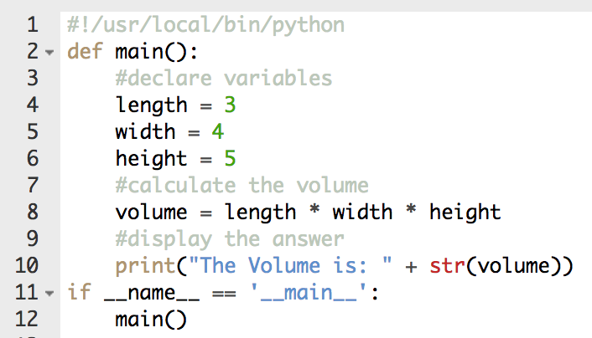
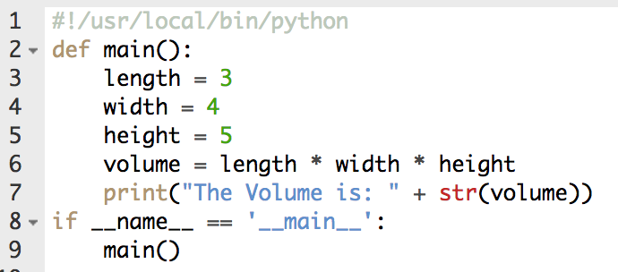
Programming Language Example
Visual Basic: https://dotnetfiddle.net/IelkjT
Python: https://codeenv.com/env/run/R1yVqR/
These are called comments

Slide 42
Low level programming language
Every bit of logic on your computer is eventually distilled into machine instructions
Examples below are assembly, machine instructions are their encoded representations (ones and zeros)
Your CPU knows what these encoded instructions are and can execute them.
Examples:
ADD : add two given numbers and store into a register
MULT : multiply two numbers and store into a register
JUMP : go to a specific instruction address and keep executing
BEQ : if a number is equal to another number jump to an address
NOOP: literally do nothing
Register 1 Data: 0
Register 2 ADDI R1, R1, 1
Register 3 JUMP R2
Register ...
Register N
Notes:
An Abacus
ENIAC (first electronic computer)

Slide 43
High Level Review
Your code is made into more primitive instructions your CPU can understand. When you run this program, your operating system (the primary program running on your cpu) will allocate system resources (CPU time, RAM et al) , letting the new program operate however you instructed it to.
You will have data and operations. The composition of your program (your code) will determine what meaningful output the program has.

Slide 44
Next Week
Install Python on our machines
Learn to write and run programs
Python as a calculator

Slide 45
Questions/ Comments?

